Slide 1



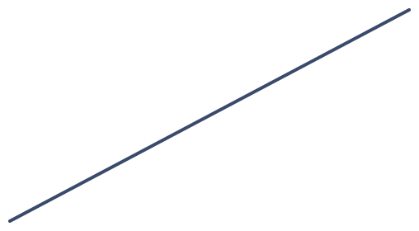
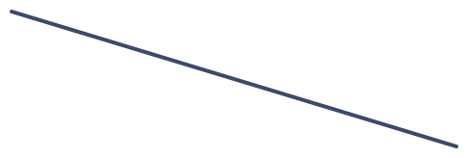

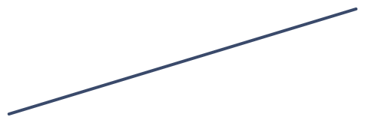

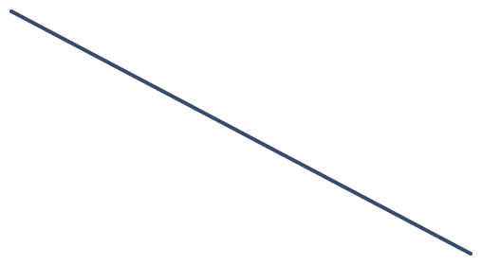
Adaptive Load Balancing Using Intelligent Routing in Computer Networks
NS-3 NETWORK SIMULATION PROJECT
A Q-Learning router that moves traffic away from a server that slows down
Rohit Kumar · B.Tech, MITS Gwalior
Notes:
Namaste sir. Is project mein humne NS-3 simulator mein ek load balancer banaya hai jo traffic ko servers mein baantta hai. Khaas baat ye hai ki jab koi server slow ho jaata hai, to hamara Q-Learning router khud seekh ke traffic ko dusre servers ki taraf mod deta hai. Aage hum problem, method, NetAnim ka live demo aur results dikhayenge.

Slide 2
Fixed rules keep sending traffic to a slow server
THE PROBLEM
Round Robin
Weighted Round Robin
When a server slows down
Every server gets a turn in order, however busy it is.
Stronger servers get a bigger share, but the shares are set once and never change.
Its queue grows and every user routed there waits longer. The rules cannot notice.
Our goal: a router that reads live feedback and adapts on its own.
Adaptive Load Balancing · NS-3
2
Notes:
Sir, aaj ke zyada tar load balancers fixed rules pe chalte hain. Round Robin sabko baari-baari se request deta hai. Weighted Round Robin strong server ko zyada hissa deta hai, lekin ye hissa ek baar tay hone ke baad badalta nahi. Problem tab aati hai jab koi server beech mein slow ho jaaye. Rule ko pata hi nahi chalta, to wahi server utni hi requests lete rehta hai aur users ko wait karna padta hai. Hamara goal ek aisa router banana tha jo live feedback dekh ke khud adjust kare.

Slide 3
What we set out to build
OBJECTIVES
01
02
03
Build a working load-balancing network in NS-3
Implement four routing methods in one balancer
Generate realistic, bursty Poisson traffic
04
05
06
Slow one server down in the middle of a run
Compare delay, loss, throughput and balance
Verify with FlowMonitor and NetAnim
Adaptive Load Balancing · NS-3
3
Notes:
Humare chhe objectives the. Pehla, NS-3 mein ek asli network banana. Doosra, ek hi load balancer ke andar chaar routing methods rakhna taaki fair comparison ho. Teesra, Poisson traffic, yaani random aur bursty requests, jaise real duniya mein hoti hain. Chautha, beech simulation mein ek server ko slow karna. Paanchva, delay, packet loss, throughput aur load balance compare karna. Aur chhatha, results ko FlowMonitor ke numbers aur NetAnim ke visual dono se verify karna.

Slide 4
Static rules against live feedback
EXISTING VS PROPOSED
Aspect | Static methods | Our intelligent methods
Server choice | Fixed order or fixed weights | Live queue length, or a learned Q-value
Slow server | Same share keeps arriving | Traffic shifts away within the run
Tuning | Weights set by hand | The agent learns from response times
Network feedback | None | Queue length and response time from NS-3
Failure test | 74.5 ms and 87.1 ms | 47.3 ms and 42.7 ms
Adaptive Load Balancing · NS-3
4
Notes:
Ye table existing aur proposed system ka seedha comparison hai. Static methods fixed order ya fixed weights use karte hain, to slow server pe bhi wahi share aata rehta hai aur weights haath se set karne padte hain. Hamare intelligent methods live queue length ya seekhi hui Q-value dekhte hain, isliye traffic khud shift ho jaata hai. Aakhri row sabse zaroori hai: failure test mein static methods 74.5 aur 87.1 millisecond pe gaye, jabki hamare dono methods 47.3 aur 42.7 pe rahe.

Slide 5
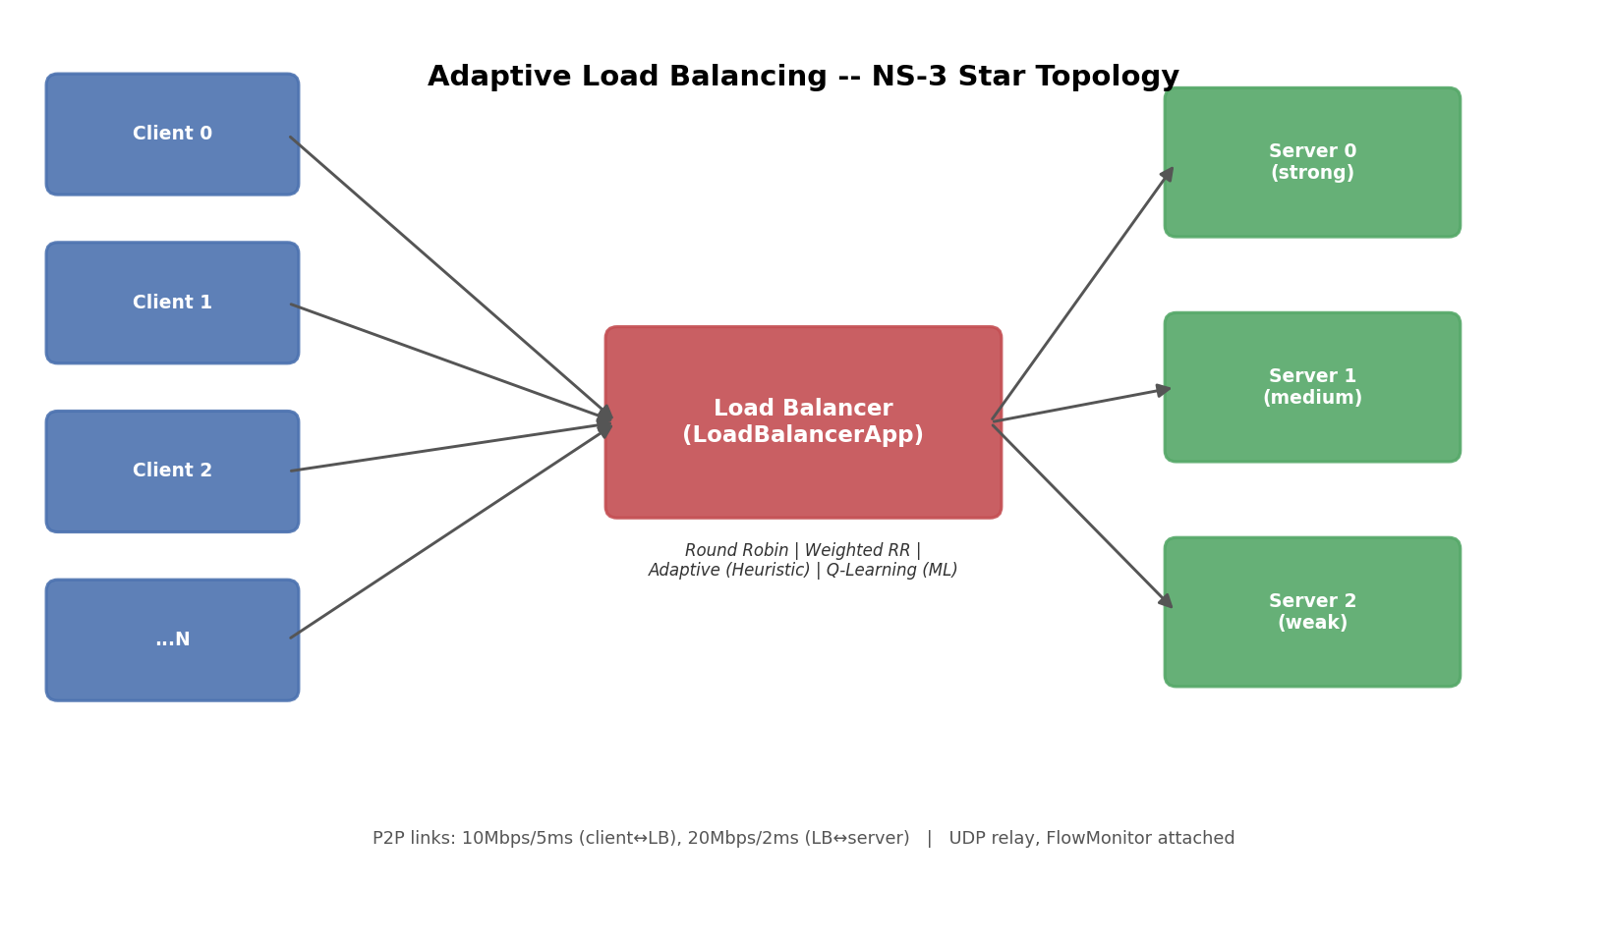
A star network with one smart middleman
SYSTEM ARCHITECTURE
Clients on one side, three servers of different strength on the other, the load balancer in the middle.
It works like a reverse proxy: it forwards every request and relays the answer back.
Links: 10 Mbps and 5 ms to the clients, 20 Mbps and 2 ms to the servers.
Adaptive Load Balancing · NS-3
5
Notes:
Ye hamara network ka structure hai. Beech mein load balancer, ek taraf clients, doosri taraf teen servers jo alag-alag taakat ke hain: strong, medium aur weak. Load balancer reverse proxy ki tarah kaam karta hai, yaani request leta hai, server ko bhejta hai, aur server ka jawab wapas client ko deta hai. Client aur balancer ke beech 10 Mbps aur 5 millisecond ka link hai, balancer aur server ke beech 20 Mbps aur 2 millisecond ka.

Slide 6
One request, five steps
HOW IT WORKS
1
2
3
4
5
A client sends a UDP request to the balancer
The balancer picks a server with the active method
The server works on it, then replies
The balancer relays the reply to the client
The client records the round-trip time
With Q-Learning on, step 5 is also the lesson: a faster round trip means a higher reward for the server that was picked.
Adaptive Load Balancing · NS-3
6
Notes:
Ek request ka poora safar paanch steps mein hota hai. Pehle client UDP request balancer ko bhejta hai, har request ke saath ek 4-byte ID hoti hai. Doosre step mein balancer active method se server chunta hai. Teesre mein server request pe kaam karta hai aur jawab bhejta hai. Chauthe mein balancer wo jawab sahi client tak pahunchata hai. Aur paanchve mein client poora round-trip time note karta hai. Q-Learning mein yahi time reward ban jaata hai.

Slide 7
Four ways to pick a server
ROUTING METHODS
Fixed
Fixed
Live signal
Learned
Round Robin
Weighted RR
Adaptive
Q-Learning
Servers take turns in a fixed order.
Share follows declared capacity: 60, 45 and 30 requests per second.
Reads each link’s queue. Lowest score of 10 × queue + active requests wins.
Learns from response times which server to pick. Explores early, exploits later.
All four sit in the same balancer class and are switched with one flag, so only the decision rule changes between runs.
Adaptive Load Balancing · NS-3
7
Notes:
Hamare paas chaar methods hain. Round Robin sirf baari-baari se deta hai. Weighted Round Robin capacity ke hisaab se hissa deta hai, lekin wo fixed hai. Adaptive method har link ki live queue padhta hai aur score nikaalta hai: 10 guna queue length plus active requests, jiska score sabse kam, wahi server chuna jaata hai. Aur Q-Learning response time se seekhta hai ki kaunsa server behtar hai. Sabse zaroori baat: chaaron ek hi class ke andar hain aur ek flag se badalte hain, isliye comparison fair hai.

Slide 8
Q-Learning: learn which server is fastest
MACHINE LEARNING
State
Action
Reward
The congestion level of each server: low, medium or high
Which server gets the next request
Minus the response time, so faster answers score higher
Q(s,a) ← Q(s,a) + α [ r + γ · max Q(s′,a′) − Q(s,a) ]
Learning rate α = 0.3 · discount γ = 0.5 · exploration starts at 0.3 and decays to 0.05
Adaptive Load Balancing · NS-3
8
Notes:
Ye hamara machine learning wala hissa hai. Q-Learning mein agent teen cheezon se kaam karta hai. State, yaani har server kitna busy hai: low, medium ya high. Action, yaani agla request kis server ko jaaye. Aur reward, jo response time ka negative hai, to jitna tez jawab, utna zyada reward. Har request ke baad ye formula Q-table ko update karta hai. Shuru mein agent thoda random try karta hai, jise exploration kehte hain, aur dheere-dheere sabse achhe server ko prefer karna seekh leta hai. Alpha 0.3 aur gamma 0.5 hamari settings hain.

Slide 9
Same network, eight runs
SIMULATION SETUP
Simulator | NS-3 (C++), custom Application classes
Topology | 1 load balancer, 8 clients, 3 servers
Server capacity | 60, 45 and 30 requests per second
Traffic | UDP, Poisson arrivals, 10 requests per second per client
Duration | 40 seconds per run
Failure test | Server 0 drops to 3 requests per second from 14 s to 28 s
Measured with | Response time, FlowMonitor delay, loss and throughput
4 methods × 2 scenarios = 8 runs
Adaptive Load Balancing · NS-3
9
Notes:
Ye hamare simulation ki settings hain. Simulator NS-3 hai aur code C++ mein custom Application classes ke roop mein likha hai. Topology mein 1 load balancer, 8 clients aur 3 servers hain. Servers ki capacity 60, 45 aur 30 requests per second hai. Traffic UDP hai aur Poisson process se aata hai, har client 10 requests per second bhejta hai. Har run 40 second ka hai. Failure test mein Server 0 ki speed 14th se 28th second tak sirf 3 requests per second reh jaati hai. Chaar methods aur do scenarios milake kul aath runs hue.

Slide 10
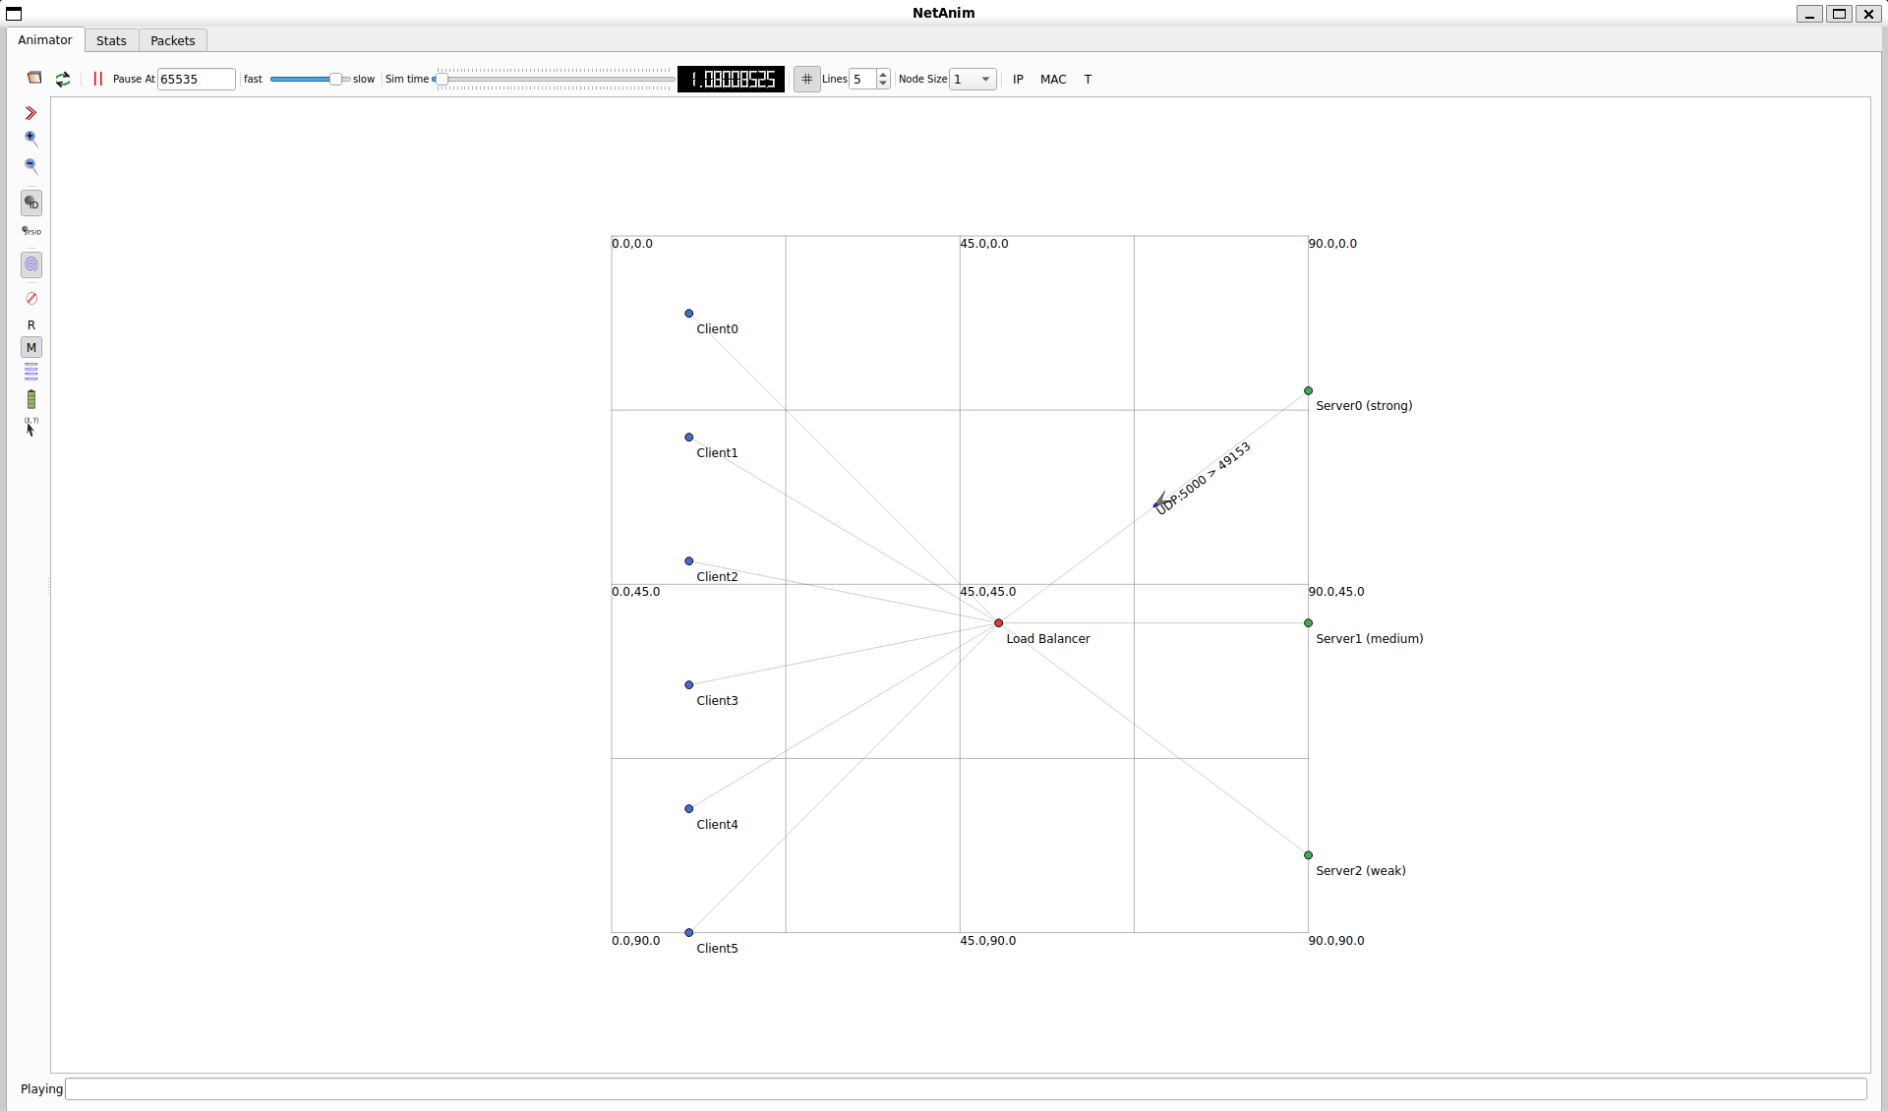
The simulation, running on our own machine
LIVE DEMO · NETANIM
Blue dots are the clients, the red dot is the load balancer, green dots are the servers.
The arrow on a link is a real UDP packet in transit.
NS-3 writes the animation file itself, so every packet shown was produced by the simulation.
Adaptive Load Balancing · NS-3
10
Notes:
Ye NetAnim ka screenshot hamari apni machine se liya gaya hai. Yahan simulation chal rahi hai. Neele dots clients hain, laal dot load balancer hai, aur hare dots teen servers hain, jinke naam ke saath strong, medium aur weak likha hai. Link ke upar jo chhota arrow aur label dikh raha hai, wo ek asli UDP packet hai jo us waqt LB se Server0 ki taraf ja raha hai. Ye animation NS-3 ki trace file se bani hai, yaani koi pehle se bani hui video nahi hai, har packet simulation ne khud banaya hai. Demo mein Play dabao aur slider ko slow karke ek packet ko follow karke dikhao.

Slide 11
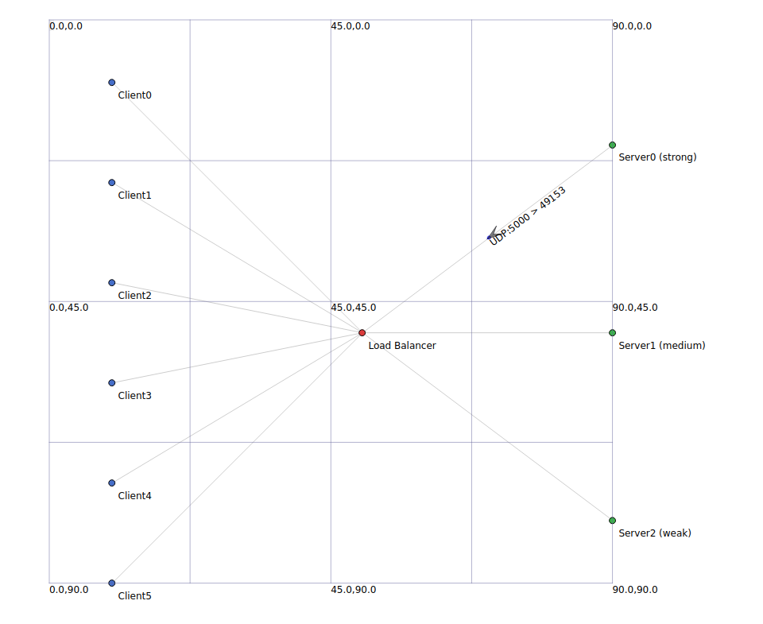
Reading the NetAnim screen
LIVE DEMO · NETANIM
You see | It means
Blue dots | Clients sending requests
Red dot | The load balancer
Green dots | Servers: strong, medium, weak
Thin lines | Network links
Arrow, label | A real packet in transit
In the failure run, Server0 turns red and is labelled SLOW while it is degraded.
Adaptive Load Balancing · NS-3
11
Notes:
Ye NetAnim screen ko padhne ka tareeka hai. Neele dots clients hain jo requests bhej rahe hain. Laal dot load balancer hai. Hare dots servers hain, jinke label mein strong, medium aur weak likha hai. Patli lines network links hain. Aur link pe jo chhota arrow aur label dikhta hai, wo ek asli packet hai jo us waqt travel kar raha hai. Agar failure scenario ka animation chalaaoge to beech mein Server0 laal ho jaata hai aur uske naam ke saath SLOW likha aata hai. Wahi moment dikhata hai ki hamara router traffic kahan mod raha hai.

Slide 12
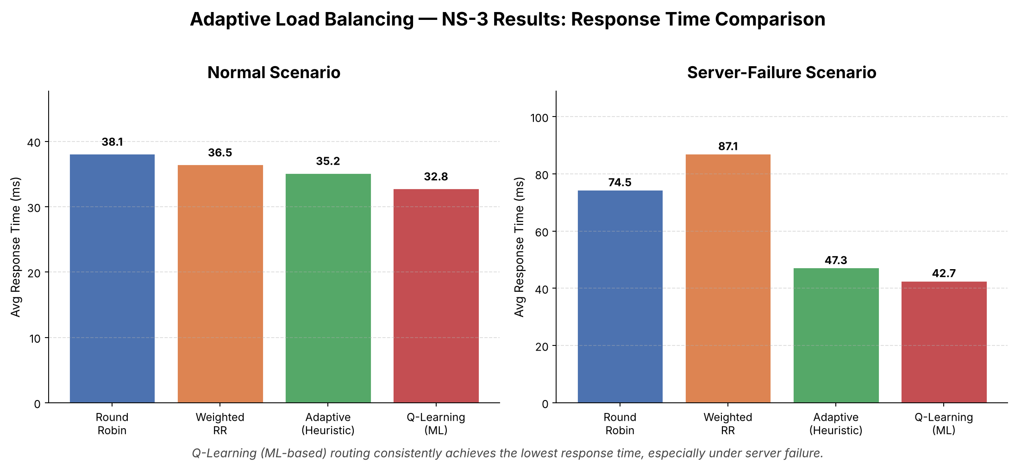
Q-Learning answers fastest in both runs
RESULTS · RESPONSE TIME
Adaptive Load Balancing · NS-3
12
Notes:
Ye chart average response time dikhata hai, jitna kam utna behtar. Baayein taraf normal run hai, jisme Q-Learning 32.8 millisecond pe hai aur Round Robin 38.1 pe. Daayein taraf failure run hai, jahan Round Robin 74.5 aur Weighted Round Robin 87.1 millisecond tak chale gaye, jabki Adaptive 47.3 aur Q-Learning 42.7 pe rahe. Dhyan do ki Weighted Round Robin failure mein Round Robin se bhi kharab hua, kyunki uske weights kabhi update nahi hote.

Slide 13
When Server0 slows down, learning wins
KEY RESULT · FAILURE RUN
74.5 ms
42.7 ms
43%
Round Robin, average response time
Q-Learning, in the same test
lower response time than Round Robin
In the normal run Q-Learning is still 14% faster. Packet loss stays under 0.07% and throughput is about 78 responses per second for every method.
Adaptive Load Balancing · NS-3
13
Notes:
Ye hamara sabse zaroori result hai. Failure run mein Round Robin ka average response time 74.5 millisecond raha, jabki Q-Learning ka 42.7. Yaani lagbhag 43 percent kam. Normal run mein bhi Q-Learning 14 percent tez raha. Packet loss 0.07 percent se neeche raha aur throughput sabhi methods ka lagbhag barabar, 78 responses per second, raha. Matlab fayda traffic ko behtar jagah bhejne se aaya hai, packets girane se nahi.

Slide 14
Where the requests went
RESULTS · LOAD DISTRIBUTION, FAILURE RUN
Method | Server0 (strong) | Server1 (medium) | Server2 (weak)
Round Robin | 1,046 | 1,046 | 1,045
Weighted RR | 1,394 | 1,046 | 697
Adaptive | 1,143 | 1,275 | 719
Q-Learning | 792 | 1,947 | 398
Only Q-Learning moved most of the traffic to the healthy medium server.
Adaptive Load Balancing · NS-3
14
Notes:
Ye table batata hai ki failure run mein har method ne kitni requests kis server ko bheji. Round Robin lagbhag barabar baantta raha, 1046, 1046 aur 1045, chahe Server0 slow tha. Weighted Round Robin ne Server0 ko sabse zyada, 1394, bheji kyunki uske weights mein wo strong tha. Adaptive ne kuch traffic hataya. Aur Q-Learning ne Server0 ko sirf 792 aur healthy medium server Server1 ko 1947 requests bheji. Yaani wahi kiya jo ek samajhdaar operator karta.

Slide 15
Live feedback beats fixed rules
CONCLUSION
1
The learning-based and adaptive routers beat the fixed ones in both runs, and the gap grows when a server slows down.
2
Q-Learning worked this out from response times alone, with no rule saying which server had failed.
3
Static weights can hurt: Weighted RR did worse than plain Round Robin once Server0 degraded.
Limits: one topology, one injected slowdown, one run per setup.
Adaptive Load Balancing · NS-3
15
Notes:
Nishkarsh mein teen baatein. Pehli, live feedback wale methods, yaani Adaptive aur Q-Learning, dono runs mein fixed methods se behtar rahe, aur failure mein ye fark bahut badh gaya. Doosri, Q-Learning ne ye sab sirf response time dekh ke seekha, use kisi ne nahi bataya ki kaunsa server kharab hai. Teesri, static weights nuksaan bhi kar sakte hain, jaise Weighted Round Robin failure mein Round Robin se bhi peeche gaya. Hum imandari se ye bhi maante hain ki ye ek hi topology, ek hi slowdown aur har setup ke ek run ka result hai.

Slide 16
Where this can go next
FUTURE SCOPE
01
Repeat every run with several random seeds and report the spread
02
Replace the Q-table with a neural network (Deep Q-Learning)
03
Try more servers, bigger topologies and full server crashes
04
Test with real TCP traffic and varied request sizes
05
Apply the same idea inside a software-defined network controller
Adaptive Load Balancing · NS-3
16
Notes:
Aage ke liye paanch idea hain. Pehla, har run ko alag-alag random seeds ke saath dohrana taaki result ka spread bhi dikhe. Doosra, Q-table ki jagah neural network, yaani Deep Q-Learning, use karna. Teesra, zyada servers, bade topologies aur poore server crash try karna. Chautha, asli TCP traffic aur alag-alag request sizes ke saath test karna. Aur paanchva, isi idea ko software-defined network controller mein lagana.

Slide 17
Thank you
QUESTIONS WELCOME
Source code, results and the NetAnim file: github.com/Rohitsaral/adaptive-load-balancing-ns3
Rohit Kumar · B.Tech, MITS Gwalior
Notes:
Dhanyavaad sir. Poora source code, results aur NetAnim ki file hamare GitHub repository mein available hai. Ab aap koi bhi sawaal pooch sakte hain.

